Slide 1
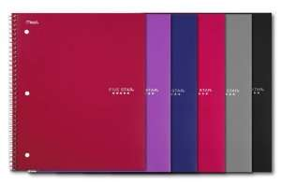
Interactive Notebooks

Slide 2
Kristi Neuroth
kristi.neuroth@wcs.edu AP Human Geography/World Geography Ravenwood High School
Ashley Flood
ashley.flood@wcs.edu AP Human Geography/World History Franklin High School

Slide 3
So, what is an Interactive Notebook?
How many of you have heard of an Interactive Notebook?
Have you used an Interactive Notebook?

Slide 4
Agenda:
Introduction to the interactive notebook
How to introduce the notebook to students
Research
Goals of the interactive notebook
Organization of interactive notebook
Examples of student “interactions”
Variations of the notebook
Disclaimers
Grading the notebook
Value of using the notebook
Questions

Slide 5
Part 1
Let’s begin with an experiment…

Slide 6
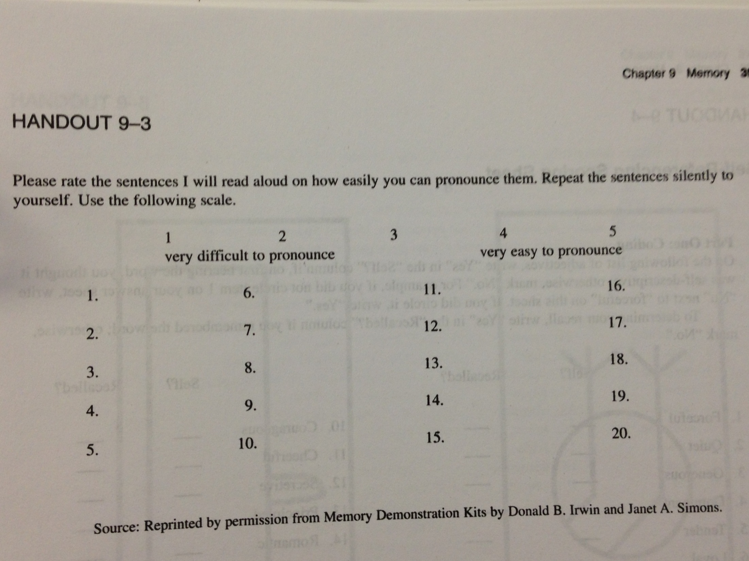

Slide 7
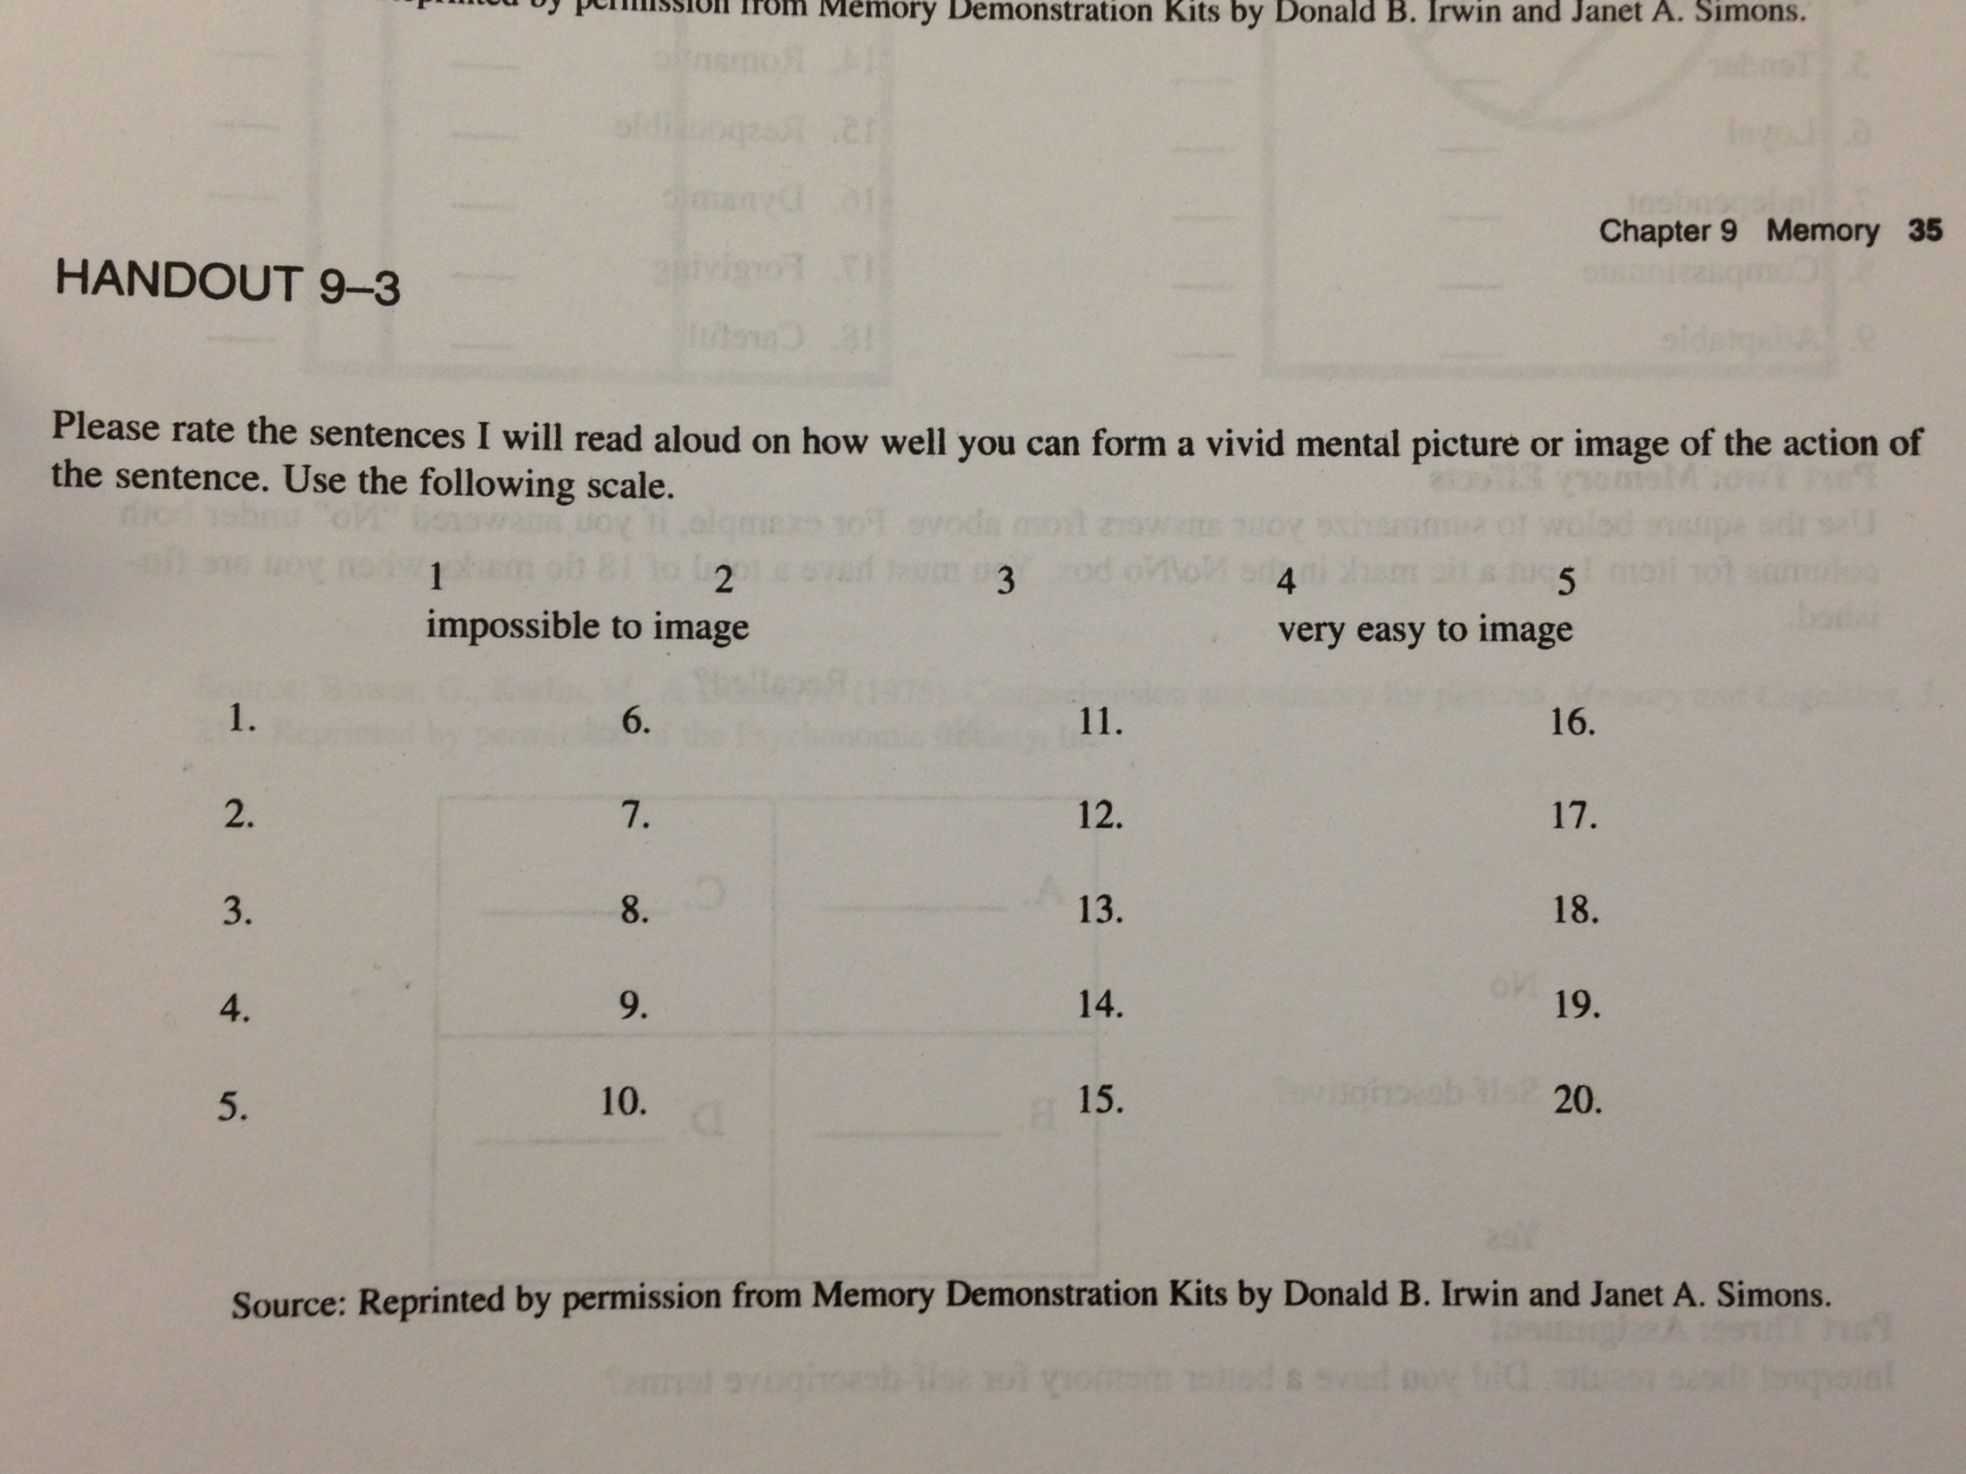

Slide 8
PART 2
The Research/
Nuts and Bolts

Slide 9
What Research Says…
Encoding (get info into our brain)
Visual (Pictures)
Semantic (Meaning)
Acoustic (Sound)
Why Color?
Color is a most powerful stimulus for the brain.
The brain sees and remembers color first!
Color opens the mathematical process and scientific process
Color is a frequency that can connect and create a neuropathway
Connector to all the types of intelligences we have

Slide 10
What are the goals of the Interactive Notebook?
1. To create personal meaning with information that has been covered in class or the textbook
2. To give a built-in opportunity to organize and review materials as we go along
3. To have everything from one chapter/unit in one spot, so all your study materials are in one place
4. To teach you study techniques that can be implemented in other classes

Slide 11
 | Right Side
 | Date Title The right side basics: • Where the teacher organizes a common set of information that all students must know. • Gives students the “essentials”

Slide 12
 | Right Side
 | Date Title THE “INPUT” SIDE -used for recording notes -typically, all “testable” information is found here -place for illustrated outlines, flow charts, annotated slides, T-charts, and other graphic organizers -handouts with new information also go on the right side

Slide 13
Left Side
Date Title The left side of the notebook: • Clearly indicates which ideas are the teacher’s and which ideas belong to the student. • Stresses that writing down lecture notes does not mean students learned the information. Students must actively do something with the information before they internalize it. • Provides permission to question, to be playful, and to experiment because students know the left side is their page and will not be interfering with class notes. • Allows students to use various learning styles to process information.

Slide 14
Left Side
Date Title THE “OUTPUT”SIDE -primarily used for processing new ideas -illustrations, diagrams, flow charts, poetry, colors, matrices, cartoons, etc… -explore opinions and clarify values on controversial issues -wonder about “what if” hypothetical situations, and ask questions about new ideas -record feelings and reactions to activities that tap into intrapersonal learning -review what students learned and preview what they will learn in the future -see how individual lessons fit into the larger context of a unit

Slide 15
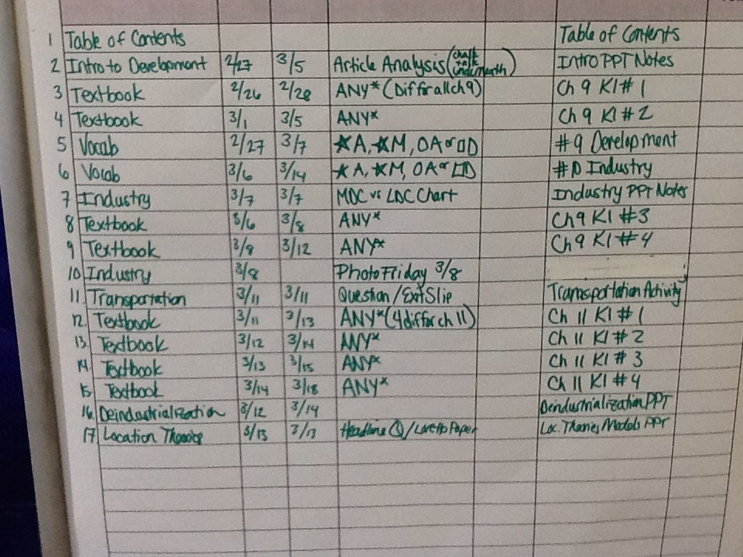
Organization
Keeping a table of contents in the front of the classroom is very helpful!

Slide 16
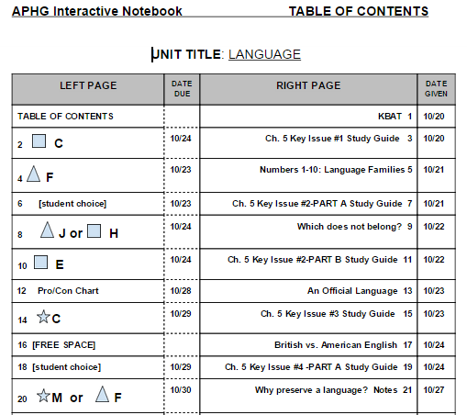
Use a Google Doc so students & parents can access at home

Slide 17
Organization
Student rubrics
Have students self-grade before submitting

Slide 18
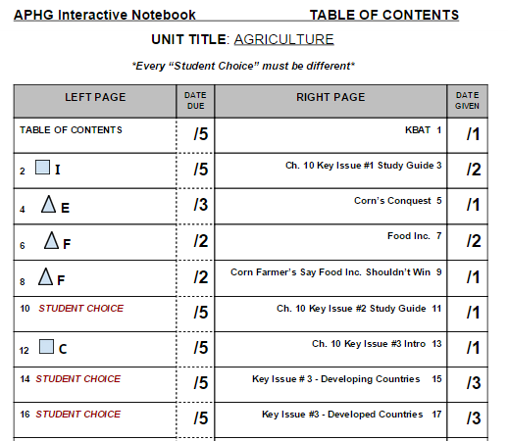
Organization
Student Rubric

Slide 19
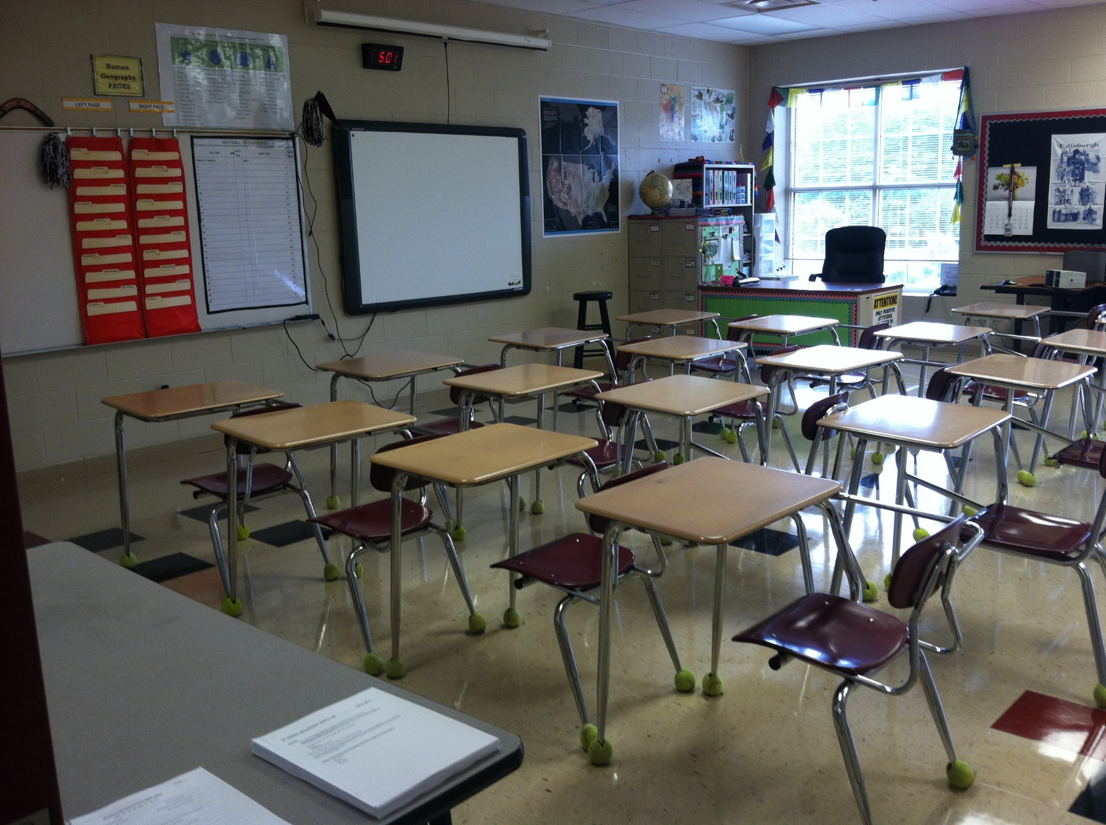
Ideas for setting up your classroom
List of Interactions
Table of Contents
Extra Copies
New Handout for today

Slide 20
Grading – 2 ways
First way: Grading frequently
Students have 48 hours from the time the right page is given in class to “interact” with it on the left page
Spot checks can be done in class for completion or accuracy
Points awarded at teacher discretion

Slide 21
Grading – 2 ways
Second way: End of chapter/unit grading (everything is graded)
-There will be a running rubric on the board with the necessary right and left page requirements and point values
-Turned in the day of the test

Slide 22
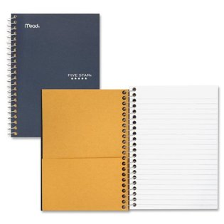
Variations on the use of the Interactive Notebook
Model the use of the Interactive Notebook by going over the syllabus
Use of the pockets

Slide 23
Values of using the Interactive Notebook
1. Formative assessment
2. Opportunity for one-on-one interaction
3. Great opportunity for modeling
4. Differentiation

Slide 24
Direction Handouts on the
ISN Website

Slide 25
Interactions

Slide 26
So, what are “interactions”?

Slide 28
Ideas that work in any class…
Entry/exit slips
Reflections on assignment, activity, homework
Connections to the real world, personal life
Questions about the lesson
Summary
Student examples
Summary of a think-pair-share activity
Internet examples from many classes

Slide 29
Create interactions that will work in your content area:
Peruse the notebooks laying out on the tables
Think of a specific interaction that would work well for a lesson or standard you teach
Write your ideas on your group’s poster paper

Slide 30
Disclaimers…

Slide 31
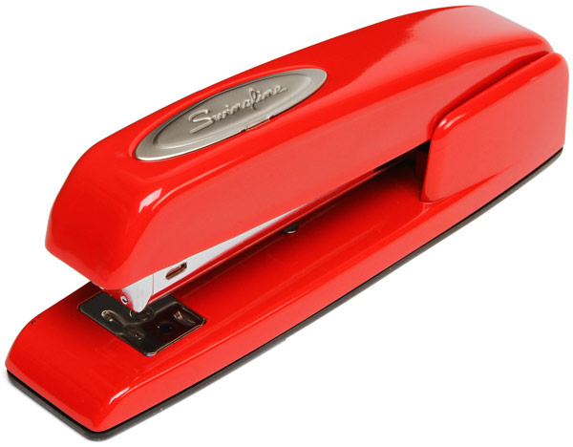
Disclaimers…
Teaching students how to use the ISN takes a lot of time at the beginning of year, at least a month
(think of this as scaffolding)
2. Staplers work better

Slide 32
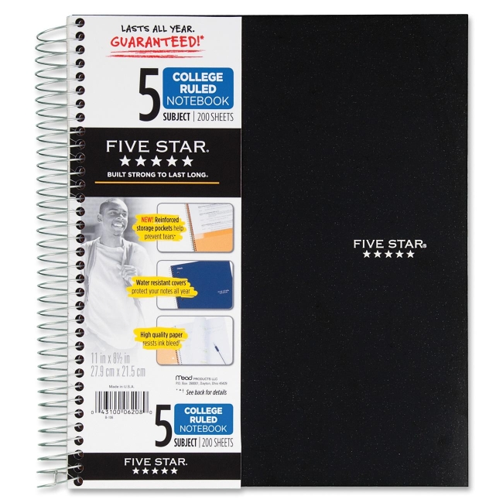
Disclaimers…
3. Notebook:
Mead
COLLEGE RULED 5-Star
5-Subject
9” x 11”

Slide 33
Disclaimers…
You MUST figure out a way to grade that is
effective for YOU– tailor the ISN to your teaching
style and time availability.
5. Color
- Not about artistic value, but creating meaning
DON’T FOCUS ON PETTY ISSUES, remember the big picture

Slide 34
What Students have to say…
Doing more hands on activities and creative things helped me more because it is harder for me to just read and take notes.
I think the interactive notebook was most helpful when the interaction involved pictures. In the activities where we had to find pictures or draw pictures it always helped me remember the information better.
It was like having an already filled out study guide every test
its much easier than carrying a binder and you have everything in there and stapled so you don't loose it
it was ok
Going back in it to fill in my study guides was very helpful at the end. I think the interactions didn't help me very much though.
Everything was always organized and right where I needed it. It made studying a breeze.
It helped me stay organized and i didn't feel overwhelmed. We could review at any moment in time.
interactions help create a mental image
Kept life in this class very organized. I had everything in it, in order, so I wasn't scrambling before tests trying to find everything.
It was a creative way to remember information. It was organized and centralized and helped me keep information I needed throughout the year.
Looking back at interactions because they outline and display ideas and info in an easy way for studying
Nothing really. The interactions kind of took up my time

Slide 35
What teachers have to say…
The kids remembered the material better!
Students were accountable for their practice and use of class concepts.
I liked the "forced" organization, as well as the idea of getting students to use their notes to make them meaningful to them. I loved that students had to take everything a step further in making their learning useful and meaningful to them. It also easily allowed me to identify areas of improvement based on the quality of their interactions.
The organization. Students knew exactly where everything was for every chapter. The other thing is it significantly cut down on the grading I have to do. I was not collecting and handing back papers on a daily or even weekly basis. It was a one-time collection every few weeks.
Like that it incorporated their knowledge with their notes, provided accountability to take notes
It gave the students a chance to creatively interact with their notes and synthesize the information into something that makes sense and into something that they will remember.
I liked that it kept the students organized, and that their notes were right there when they did their homework.

Slide 36
What teachers would change…
I would keep track of the different items I asked them to write in notebook in order to make checking them easier.
I would stress the importance of a 5-subject notebook more, as well as the need for a mini stapler. I would also like to get more ideas for useful interactions to keep things "interesting and new".
I am working on gathering class reviews to see what I might change; one may be that rather than students doing their own interactions (not directed by me) have them summarize their nightly reading.
The only way I plan on changing next year is to look into possibly doing a separate notebook for section vocab/questions because most students had to use two notebooks this year.
I will work next year on a description for all of the interactions that I will give to make them a little clearer on expectations.
I'll be doing something very similar next year, but I'll be using a 3 ring binder instead. Everything will be in the same order as I did this year, but I give note handouts 99% of the time, so I felt I was wasting the actual paper
I'm going to use the same idea, but with a 3 ring binder next year. That way I don't waste the spirals paper, and they will all be the correct size
find a way to make it manageable - eliminate some interactions
Like I said above, I felt pressure to do a comprehensive check at the end of the unit or quarter, but that felt overwhelming to me, logistically. I do quick checks on a frequent basis, and never take the notebooks up from the kids. That's been a positive change for me.

Slide 37
Individual Application

Slide 38
Questions?

Slide 39
Feel free to contact us! Kristi Neuroth kristi.neuroth@wcs.edu Ashley Flood ashley.flood@wcs.edu

